Slide 1

Real Time Voting System

Slide 2
Introduction
Significance in the Digital Age:
Rapid analysis of voting data is essential for understanding public opinion and electoral trends.
Traditional systems face delays, scalability limitations, and lack real-time insights, impacting timely decision-making.
Key Challenges Addressed:
Delays in processing voting data
Limited ability to scale and adapt to large datasets and lack of immediate actionable insights.
Project Goal:
Develop a distributed voting system leveraging cutting-edge big data technologies to deliver real-time analytics and visualization.

Slide 3
OBJECTIVES & SCOPE
Objectives
Develop a scalable, efficient real-time voting system.
Enable real-time vote collection, processing, and data consistency.
Analyze voting patterns, geographic, and demographic trends.
Provide interactive data visualizations for actionable insights.
Scope
Data Management: Voter registration and vote casting simulated via PostgreSQL.
Real-Time Processing: Apache Kafka for message streaming and Spark for analytics.
Visualization: Interactive dashboard built with Streamlit.
Deployment in a Docker environment for scalability and ease of use.

Slide 4
Literature Review
Paper | Findings | Methodology | Gaps
"High-Performance Real-Time Data Processing" (2020) | Emphasizes using PostgreSQL and Apache Kafka for scalable and reliable real-time data management. | Kafka as a message broker to ensure high-throughput, low-latency event streaming. PostgreSQL for structured data storage and reliable event management. | Does not explore in-depth visualization strategies and interaction in a voting system context.
"A Reactive Batching Strategy of Apache Kafka for Reliable Stream Processing in Real-Time" (2021) | Introduced a batching strategy to reduce latency and enhance Kafka's throughput for real-time systems. | Applied a reactive batching strategy to optimize message processing and improve Kafka’s performance. | Lack of focus on fault-tolerant analytics and visualizing large-scale real-time data.

Slide 5
Methodology
Data Ingestion:
Used Kafka to capture and stream live voting data in real-time.
Ensured high throughput and fault tolerance during data ingestion.
Data Processing:
Used Apache Spark for distributed processing of large-scale voting data.
Implemented real-time data cleaning, aggregation, and transformation pipelines.
Data Storage:
Stored processed data in PostgreSQL for structured, reliable, and queryable storage.
Optimized database schema for fast retrieval and integration with visualization tools.

Slide 6
Methodology
Real-Time Analytics:
Designed analytical algorithms for detecting trends, patterns, and anomalies in voting data.
Enabled dynamic querying to support diverse analytical use cases.
Visualization and Dashboard:
Built an interactive dashboard using Streamlit for real-time visualization of voting data.
Integrated charts, graphs, and maps (e.g., bar charts, pie charts, and time-series trends) to present actionable insights.
Enabled filtering options and live updates to enhance user engagement and decision-making.

Slide 7
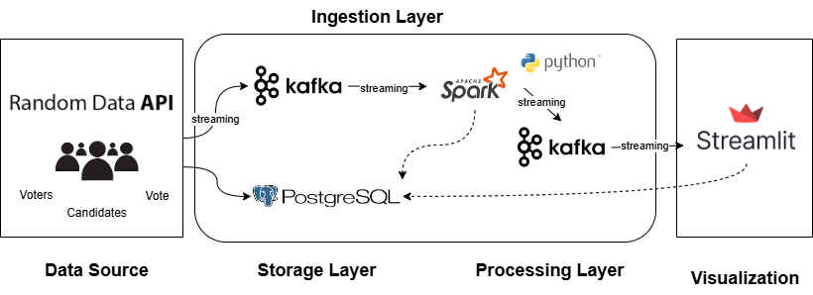
System Architecture

Slide 8
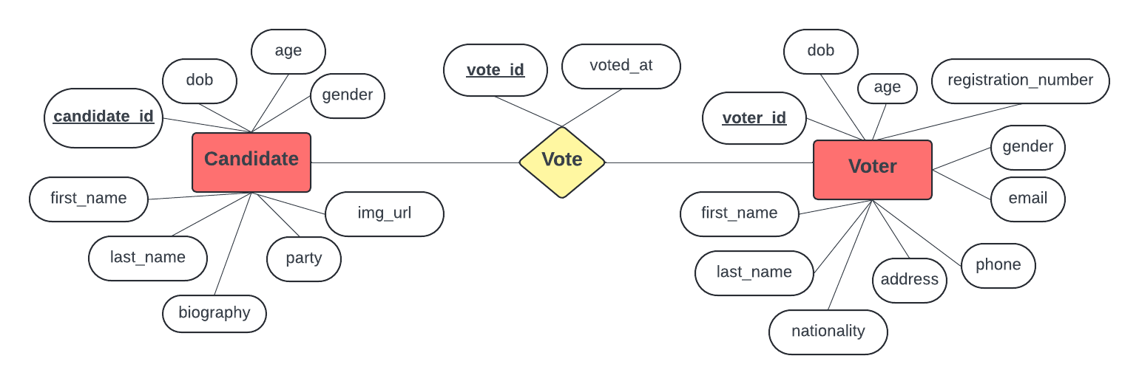
Analysis and Results

Slide 9
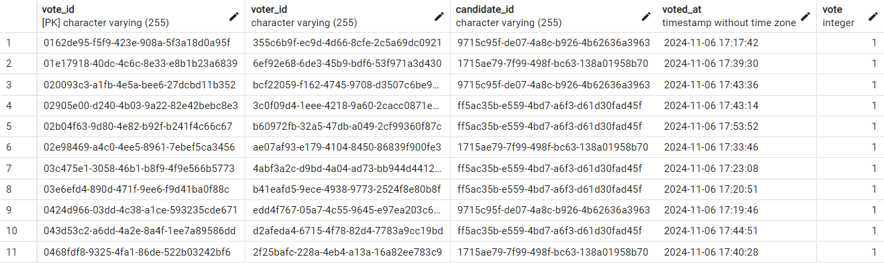
Analysis and Results

Slide 10
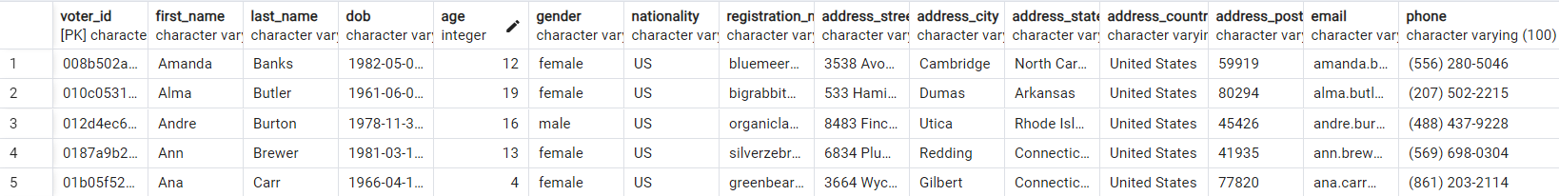
Analysis and Results

Slide 11
Conclusion
Successfully developed a scalable and robust real-time voting system leveraging big data technologies such as Docker, Kafka, Spark, PostgreSQL, and Streamlit.
Achieved a streamlined pipeline from data generation to visualization, ensuring real-time updates for both analytics and the dashboard.
Provided detailed metrics like votes by candidate, geographic trends, and demographic insights, enabling informed decision-making.
Delivered a user-friendly Streamlit dashboard that visualizes live election data with features such as time-series tracking and geographic mapping.
Optimized the system to handle high volumes of data with minimal latency, showcasing its potential for real-world election scenarios.

Slide 12
References
https://ieeexplore.ieee.org/document/10296737
https://ieeexplore.ieee.org/document/9251089
https://www.geeksforgeeks.org/how-to-use-apache-kafka-for-real-time-data-streaming/
https://towardsdatascience.com/search?q=streamlit
https://www.javatpoint.com/apache-kafka

